Slide 1
Viruses/Bacteria/Protists/Fungi
Unit 5 / Module 12

Slide 2
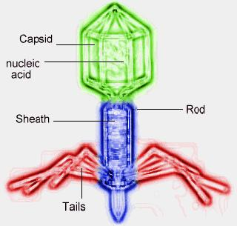
I. Is a virus a living thing?
A. Viruses, although not technically living due to the lack of cellular structure, are classified as microorganisms.
B. Viruses are composed of a protein coat (called a capsid) that protects a nucleic acid - either DNA or RNA. The shape of the capsid determines the type of cell the virus can infect.

Slide 3
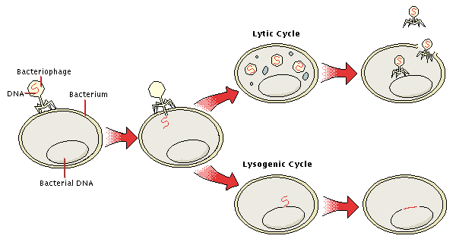
C. A virus can only exist by infecting a host cell. Viruses are classified by the reproductive cycle it uses to infect the host cell.
1. The lytic cycle describes the “life cycle” in which a virus uses the host cell to make copies of itself, then quickly kills the host cell as new virus copies are released.
2. The lysogenic cycle describes the “life cycle” in which the virus has a dormant stage in which the virus remains inactive within the cell. This dormant period may last for weeks, months, or years. An environmental trigger may cause the viral DNA to emerge from the host DNA and begin a lytic cycle of reproduction.
Flu Attack! How a virus invades your body
Lytic Cycle
Virus Lysogenic Cycle - YouTube

Slide 4
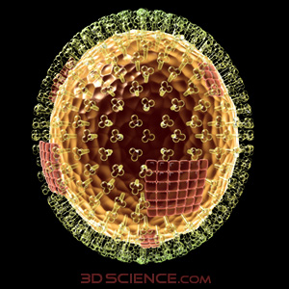
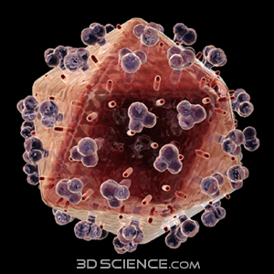
D. Viruses are pathogenic, or disease-causing microorganisms
HIV causes AIDS. HIV infects T-cells, which are important for the immune response. Thus, people with AIDS often die of opportunistic infections, such as pneumonia.
Several different viruses cause influenza (the “flu”). Influenza viruses infect respiratory cells. The lysis of these cells leads to some of the typical symptoms of the flu, such as sore throat and congestion.

Slide 5
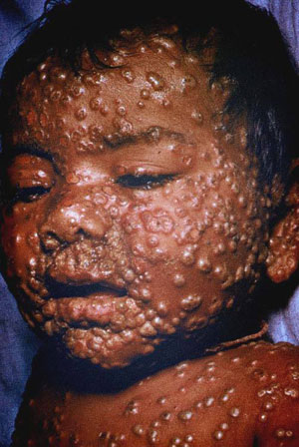
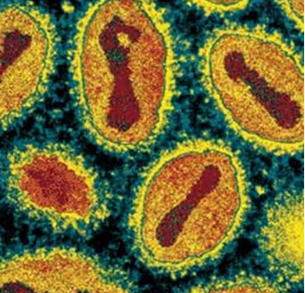
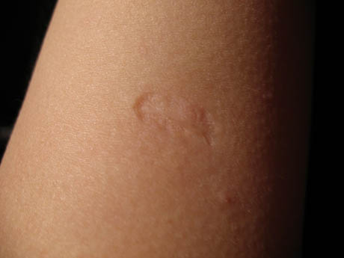
A poxvirus causes smallpox. Smallpox starts in the cells of the lymph nodes and lungs. Symptoms include severe headaches, muscle ache, and pustules on the skin.

Slide 6
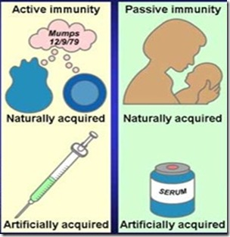
E. Virus Prevention and Treatment
1. Vaccines can be developed for viral diseases. A vaccine uses a dead or weakened form of the virus to “turn on” the immune response so that antibodies are produced.
a. Active immunity to a virus is conferred by a vaccine or by exposure to the virus itself.
b. Passive immunity is conferred when antibodies are passed between individuals (ie. through breast milk).
2.Antiviral medications work by interrupting the virus’s life cycle. Antibiotics are NOT effective against viruses!

Slide 7
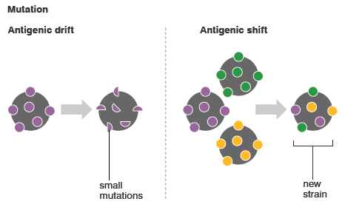
F. Viruses and Natural Selection
Viruses often mutate rapidly, meaning the actual virus being spread changes with each outbreak.
2. Mutations in the HIV virus make developing a treatment or vaccine difficult. Viruses that are resistant due to mutations can survive and reproduce by natural selection.
3. Flu epidemics are caused by viruses that are genetically different enough from earlier years’ viruses that people have little immunity to them.

Slide 8
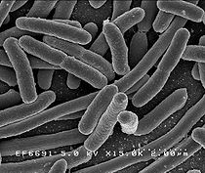
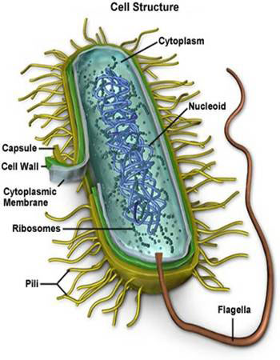
II. Are all bacteria “bad”?
A. All bacteria are classified in the kingdoms Eubacteria and Archaebacteria. They are differentiated by the chemicals found in the bacterial cell wall. They are all unicellular and prokaryotic

Slide 9
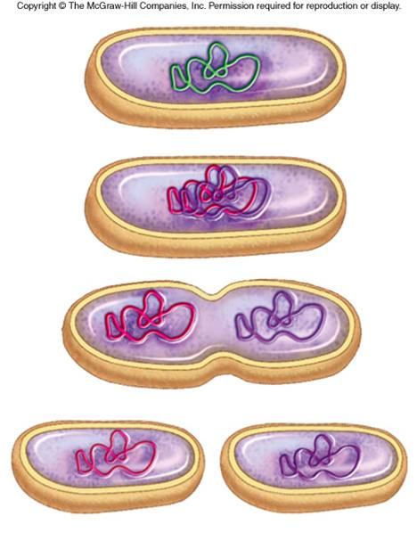
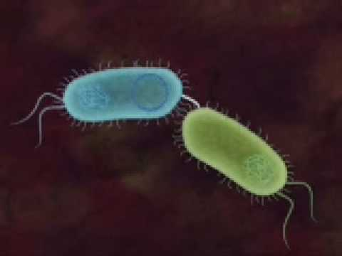
II. Are all bacteria “bad”?
B. Bacteria reproduce through binary fission but can also exchange DNA by conjugation. This allows for genetic variation.

Slide 10
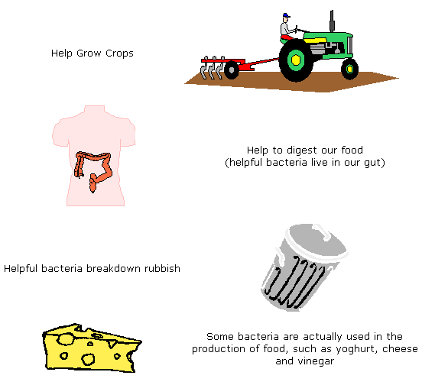
II. Are all bacteria “bad”?
C. The vast majority of bacteria in our world are beneficial. They are important decomposers and perform many other ecosystem services. They exist in the intestines of some animals and aid digestion. They are also important in food production.

Slide 11
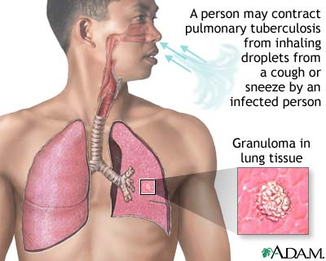
Some bacteria are pathogenic. One example is the bacterium Mycobacterium tuberculosis, which causes tuberculosis. The disease attacks the lungs and causes coughing, chest pain, fatigue and fever – it can be fatal if not treated. This bacterium causes disease because it destroys cells. The cells are broken down by the bacteria as a source of nutrition. Other bacteria harm the host by releasing toxins such the bacterium that causes food poisoning.

Slide 12
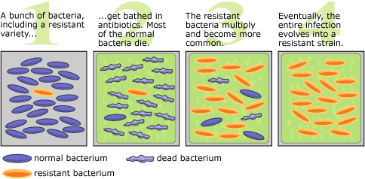
Pathogenic bacteria can be treated with antibiotics. Antibiotics kill the bacteria by destroying the cell wall. Bacteria that are resistant to antibiotics can survive and reproduce by natural selection. This means that new antibiotics must continually be developed.

Slide 13
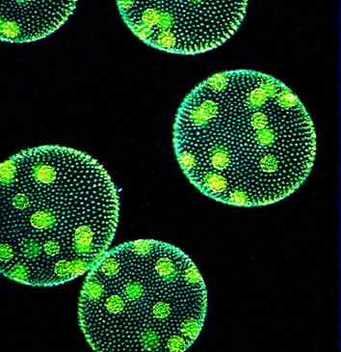
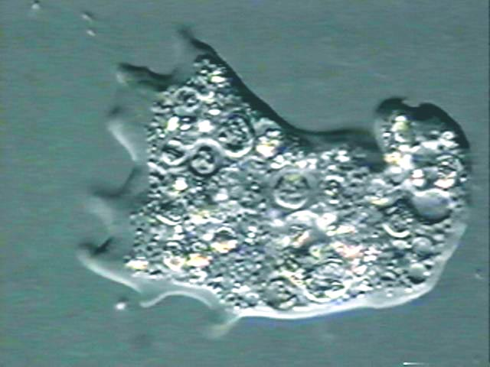
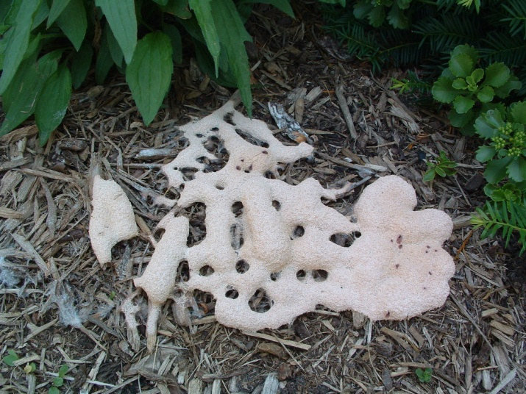
III. What is a Protist?
Protista is a diverse kingdom of organisms that is divided into 3 main groups: algae (plant-like), protozoa (animal-like) and slime molds (fungus-like).

Slide 14
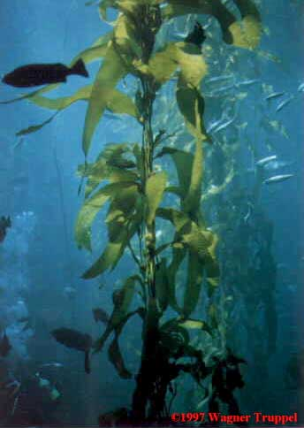
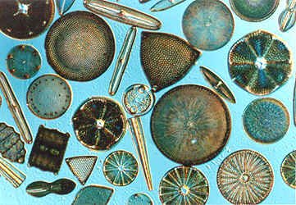
III. What is a Protist?
B. Algae are important aquatic producers (the base of aquatic food webs) and produce most of earth’s oxygen. They may be unicellular or multicellular (seaweed).

Slide 15
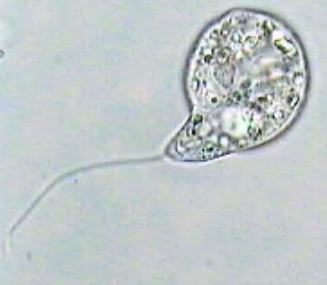
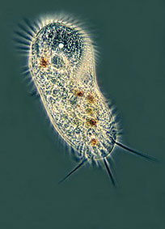
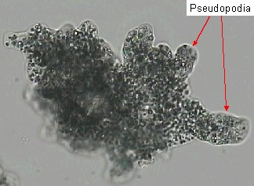
C. Protozoa are unicellular, aquatic protists that are similar to animals. Protozoa have adaptations to allow them to accomplish life functions:
1. Adaptations for movement include a whip-like tail called a flagellum, tiny hair-like projections called cilia, or extensions of the cell membrane called pseudopodia.

Slide 16
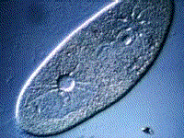
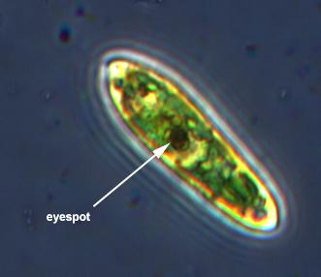
C. Protozoa are unicellular, aquatic protists that are similar to animals. Protozoa have adaptations to allow them to accomplish life functions:
2. An adaptation for water balance is the contractile vacuole. This vacuole pumps excess water out of the cell, since these aquatic organisms may take in more water than necessary by osmosis.
An adaptation for response to stimuli is the eyespot. This structure allows for responses to light (movement toward or away).

Slide 17
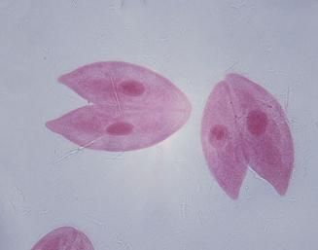
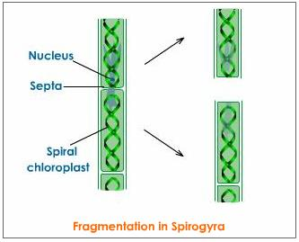
In protozoa, reproduction is asexual through binary fission, and many algae use fragmentation. Some protists may exchange DNA though conjugation.

Slide 18
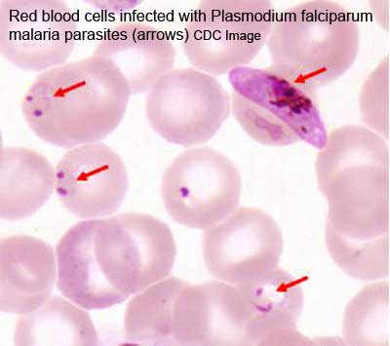
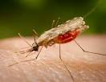
E. Some protists are pathogenic. Malaria is a disease caused by parasitic protists called plasmodia. Malaria is transmitted by a mosquito. Any organism which transmits/carries a disease without being affected by the disease is called a vector. The symptoms of malaria include headache, shaking, chills, and fever. Some forms of malaria may lead to comas, convulsions, or even death.

Slide 19
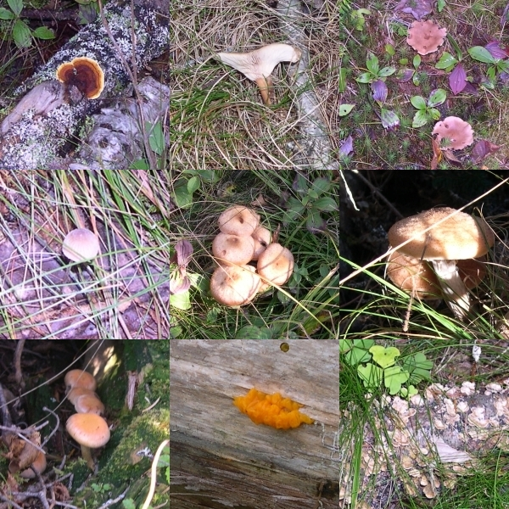
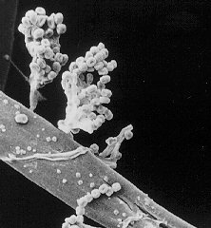
IV. How are fungi different from plants?
Fungi are eukaryotic organisms that may be unicellular or multicellular.
Fungi are heterotrophic.
They obtain food through
extracellular digestion,
secreting digestive
chemicals and absorbing
nutrients across the cell wall.

Slide 20
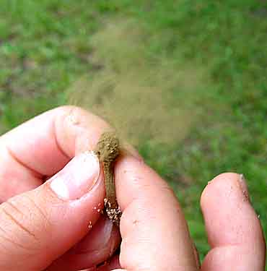
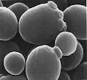
IV. How are fungi different from plants?
C. Fungi may reproduce asexually, such as budding in yeast. Spores may be used for asexual or sexual reproduction.

Slide 21
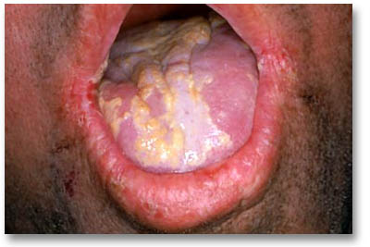
D. Some fungi are pathogenic. Candida is yeast that is a normal inhabitant of moist human epithelial tissue, such as the throat and vagina. Certain circumstances can cause Candida to become pathogenic by growing too rapidly and releasing harmful substances. This leads to conditions such as oral thrush, yeast infections, and/or kidney infections.

