Slide 1
Success with Standard Students
Shari Mudd
Butler High School

Slide 2
Of note….
There are LOTS of ways to be successful with standard students! These are practices that have worked for me.
Do what YOU feel comfortable with and what fits your personality. Things will only work if you truly buy into them.
Start whatever you decide on DAY ONE and implement with fidelity!

Slide 3
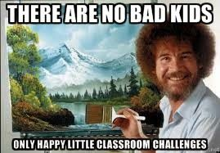
The power of a name
THE ONE THING that has made the
biggest difference in building
relationships with my students?
Greet every student at the door every day..
BY NAME…
With a SMILE ☺

Slide 4
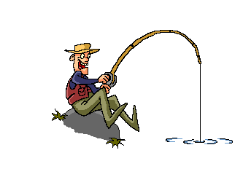
The hook….
INTRODUCE content with relevant, real-world examples
Biology is Awesome!
Also….
never underestimate the power of a gross picture.

Slide 5
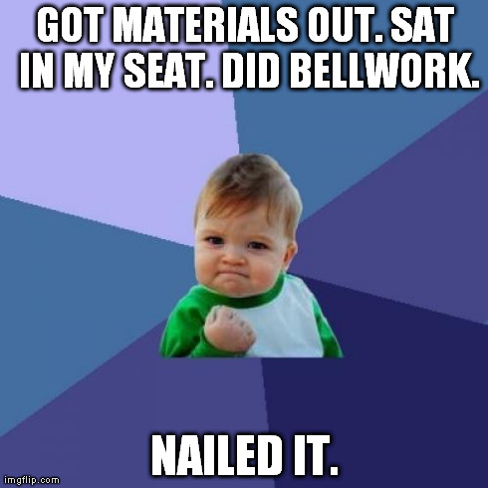
Structure and Routine
Students seem to thrive with consistency in day-to-day operations….
Standard Procedure:
Journal
Progress Check
New Content
Pre-reading
Instruction
Assignment
Click HERE for instructions on how to set up the Biology journal or use Progress Checks in your classroom!

Slide 6
Post an Agenda….
Kids like gifs, memes, or cartoons… it’s often the first thing they look for when they come in!
…and use a timer for everything!

Slide 7
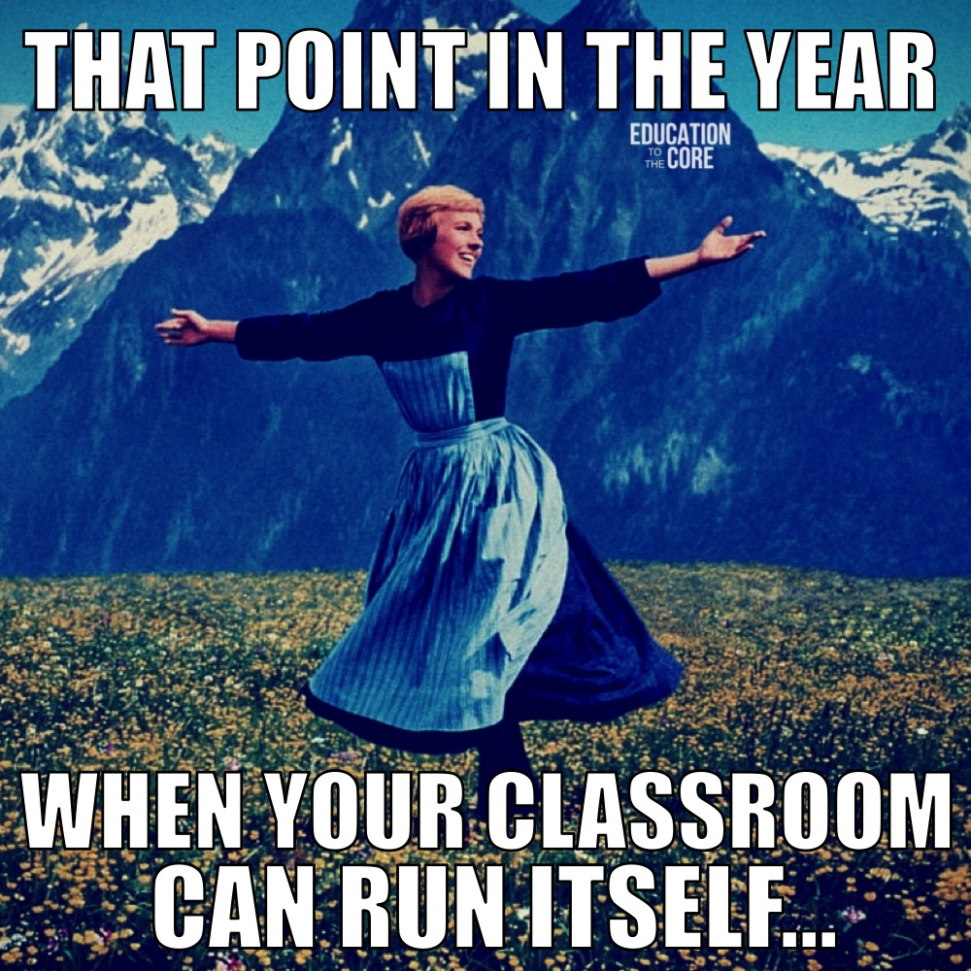
Procedures are crucial!
Have a procedure for EVERYTHING!
Lab groups
Getting / putting away chromebooks
Collecting / turning in work
Bathroom passes
What we aspire to…..

Slide 8
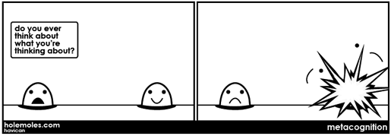
Metacognition…
Learning about learning!
That's So Meta(Cognitive)!
Students appreciate it when I explain WHY I am asking them to do something a certain way
Ex. Reading with annotation
Ex. Read text before I give them questions
Ex. De-briefing after a lab
Ex. Test corrections
All of these are metacognitive strategies!

Slide 9
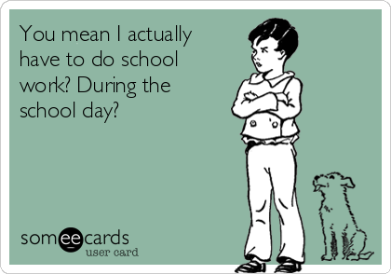
“He who works hardest learns most” – Harry Wong
Shift responsibility for “doing the work” to your students!
Emphasis on literacy can make this happen! (ILT work)
Act more as a guide than an giver of information
Teach bell-to-bell!
Reduces the need for homework
Students will come to expect this in your class and appreciate your protecting their free time

Slide 10
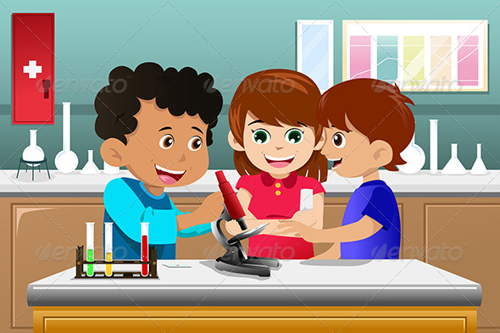
Grouping???
Grouping students correctly can make a HUGE difference in the quality (and quantity!) of group work!
This will best be done after you’ve had a couple of weeks to get to know your class…

Slide 11
Re-loop / Re-teach Ideas!
Use data to determine frequently missed
questions or topics
Use “Throwback Thursday” for review
(Thanks to T.O’Toole for the idea!)
#TBT
Test corrections can be used as a ticket to re-test
(Thanks to A.Moore for the template!)
Test corrections template found here
Journal entries that require students to explain their thinking can be used to reveal misunderstandings/misconceptions

Slide 12
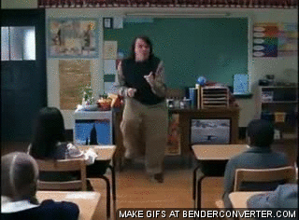
Thank you for coming today!
Link to today’s presentation:
https://tinyurl.com/successwithstandardstudents
Contact info:
shari.mudd@cms.k12.nc.us
Have a great year!

