Slide 1
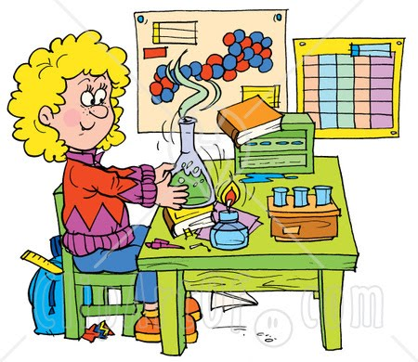
Biology Journal
If you have a spiral notebook, take it out! If not, take out notebook paper!

Slide 2
What
IS
it??
This notebook will become your own personalized JOURNAL of learning about science.
You will use your journal EVERY DAY…..just like a REAL SCIENTIST!
We will use the journal for:
Biology vocabulary
Reviewing concepts
Responding to writing prompts
Input on case studies
Current events

Slide 3
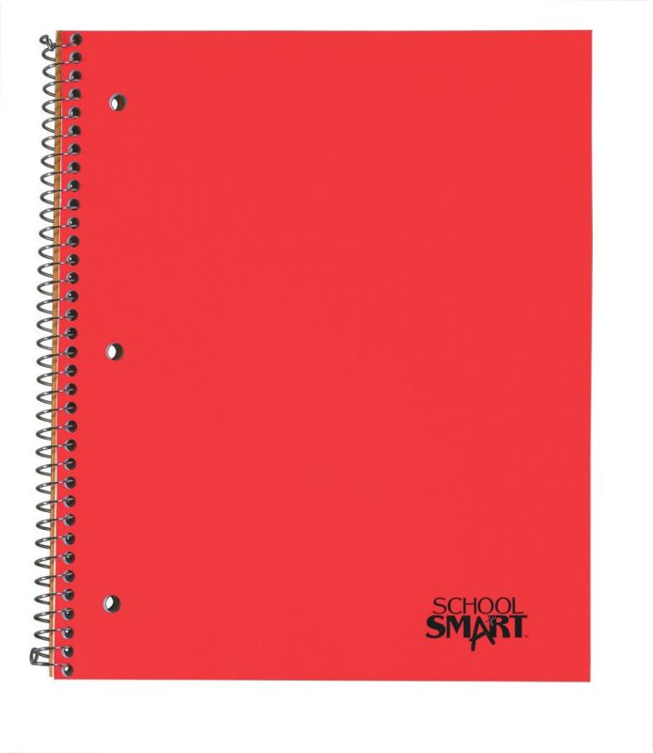
Example
Biology
Chemistry
Chemistry
Purchase a one subject, 3 hole drilled, spiral bound notebook.
Label it (use a Sharpie) with
Class name
Your name
Your class period
Your name
Your class

Slide 4
Journal Rules
-No RIPPED OUT pages or torn corners
No DOODLING that doesn’t relate to science
Journal should be used for SCIENCE CLASS ONLY
All entries must go into the Table of Contents
-BE NEAT & LOVE YOUR JOURNAL

Slide 5
Journal Grading
I will collect your journal at the end of each quarter. I will evaluate the entire journal and give a grade based on the quality, completeness, appearance, and organization.

Slide 6
Journal Grading
An important of part of your journal is its visual appearance. The journal serves as a demonstration of your learning throughout the quarter. Your journal should be neat, every entry should be titled, and every entry must have a date and page number. Your artistic touch should be visible through out the journal.

Slide 7
Grading Rubric
Exemplary Journal - 100% (A)
All notes and vocabulary are accurate, complete, and neatly organized
All journal assignments are accurate, complete, and neatly organized
All reflections are complete, neat, and follow directions

Slide 8
Grading Rubric
Standard Journal - 85% (B)
Some notes and vocabulary are accurate, complete, and neatly organized
Some journal assignments are accurate, complete, and neatly organized
Most assignments are complete and neat, but lack consistency

Slide 9
Grading Rubric
Sub-Standard Journal - 77% (C)
Many notes and vocabulary are inaccurate, incomplete, and or messy
Few or No journal assignments are accurate, complete, and neatly organized
Most assignments are incomplete, messy, or do not follow directions

Slide 10
Grading Rubric
Incomplete Journal - 50% (F)
An improved score can be earned if extra work outside of the class is done and added neatly and consistently to the journal. Work should be an extension of the current topic being studied in the class.

