Slide 1
Characteristics of Life
STERNGRR

Slide 2
6 Characteristics of all Living Things
Organization (made of CELLS)
Organism
Systems
Organs
Tissues
STERNGRR (life processes) starts here!
Cells
Molecules
Atoms / Elements

Slide 3
6 Characteristics of all Living Things
Energy Use / Metabolism
Synthesis
Transport
Nutrition
Respiration
Synthesis = to make
Transport = to move
Nutrition = food
Respiration = to make energy

Slide 4
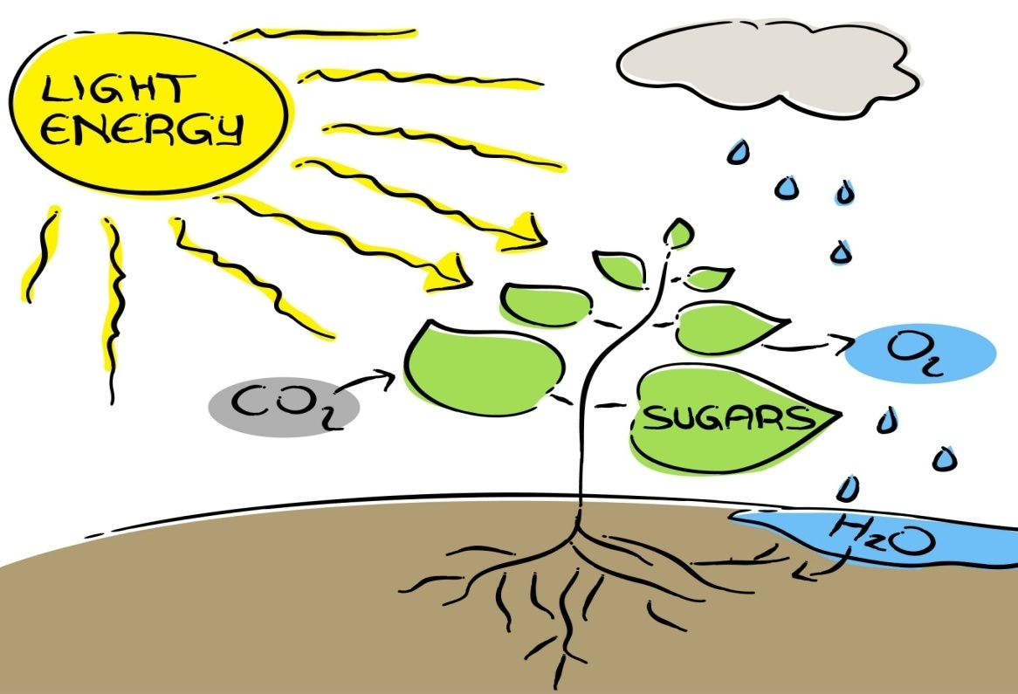
Plants use light energy of the sun to SYNTHESIZE (make) food
The blood is the body’s TRANSPORT system for moving oxygen, nutrients and wastes from one place to another.

Slide 5
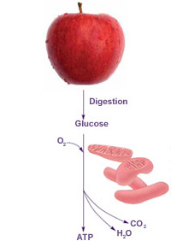
NUTRITION (food) is needed by living organisms so it can be broken down
RESPIRATION is the process used by a living organism to break down food and produce energy

Slide 6
6 Characteristics of all Living Things
Reproduction
Growth and Development
Reproduction = to make more individuals
Growth (and Development) = to get bigger and change

Slide 7
REPRODUCTION occurs when more individuals are produced
GROWTH is getter larger and development is changing

Slide 8
6 Characteristics of all Living Things
Respond to stimuli
Regulation
Adjust to environment
Regulation (ie. Excretion)
Regulation = to adjust to changes
Excretion = to get rid of

Slide 9
REGULATION includes responding to stimuli and making adjustments to help maintain homeostasis
EXCRETION helps an organism to maintain homeostasis by getting rid of waste materials

