Slide 1
Interactive Science Notebook
If you have a spiral notebook, take it out! If not, take out notebook paper!

Slide 2
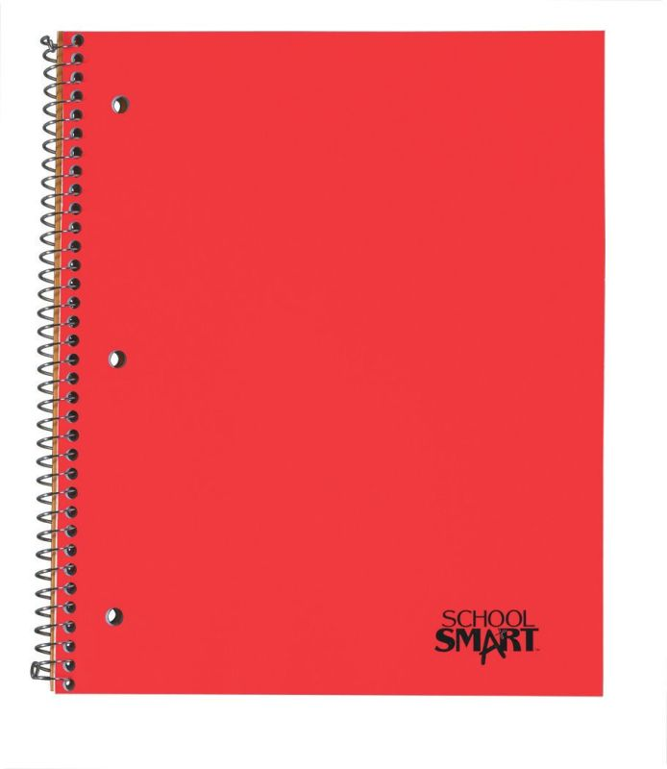
Example:
Biology
Chemistry
Chemistry
Step 1:
Purchase a one subject, 3 hole drilled, spiral bound notebook.
Label it (use a Sharpie) with
Class name
Your name
Your class period
Interactive
Science
Notebook
Your name
Your class

Slide 3
What
IS
it??
An interactive science notebook (ISN) is your own personalized JOURNAL of learning about science
A portfolio of your work in ONE convenient spot. This is great for studying for upcoming quizzes & test
A great ORGANIZATIONAL tool that gives you permission to be CREATIVE in your responses without "messing up" your notes.
Allows you to be like a REAL SCIENTIST!

Slide 6
Notebook Rules
-No RIPPED OUT pages or torn corners
No DOODLING that doesn’t relate to science
Notebook should be used for SCIENCE CLASS ONLY
All entries must go into the Table of Contents
-BE NEAT & LOVE YOUR NOTEBOOK

Slide 7
Notebook Grading
I will collect your notebook at the end of each quarter. I will evaluate the entire notebook and give a grade based on the quality, completeness, appearance, and organization.

Slide 8
Notebook Grading
An important of part of your notebook is its visual appearance. The notebook serves as a demonstration of your learning throughout the quarter. Your notebook should be neat, every entry should be titled, and every entry must have a date and page number. Your artistic touch should be visible through out the notebook.

Slide 9
Grading Rubric
Exemplary Notebook - 100% (A)
All notes and vocabulary are accurate, complete, and neatly organized
All notebook assignments are accurate, complete, and neatly organized
All reflections are complete, neat, and follow directions

Slide 10
Grading Rubric
Standard Notebook - 85% (B)
Some notes and vocabulary are accurate, complete, and neatly organized
Some notebook assignments are accurate, complete, and neatly organized
Most assignments are complete and neat, but lack consistency

Slide 11
Grading Rubric
Sub-Standard Notebook - 77% (C)
Many notes and vocabulary are inaccurate, incomplete, and or messy
Few or No notebook assignments are accurate, complete, and neatly organized
Most assignments are incomplete, messy, or do not follow directions

Slide 12
Grading Rubric
Incomplete Notebook - 50% (F)
A 100% (A+) can be earned if extra work outside of the class is done and added neatly and consistently to the interactive notebook. Work should be an extension of the current topic being studied in the class.

